Slide 1
PLACE L2 HERE (DG LEVEL)
Individual differences in the end-of-history-illusion and the effect of time horizon
Irina Levit
Inderpreet Gill
David Mandel

Slide 2
Introduction
EHI = tendency to underestimate the amount of future change, relative to past change, over the same time period
Based on the work of Quoidbach, J., Gilbert, D. T., & Wilson, T. D. (2013). The end of history illusion. Science, 339(6115), 96–98. https://doi.org/10.1126/science.1229294
  >19,000 participants across 6 studies, divided into reporters vs predictors
  Results:
    EHI effects across multiple domains: preferences, personality, values
    EHI effects occur across age, although magnitude reduces slightly in older age
    Participants overpaid for future experiences based on their current preferences, underestimating how much their preferences may change in the future

Slide 3
Experiment 1: methods
N = 1063
Between-subjects: temporal display order (“past first” vs. “future first”)
Within-subjects:
  Present, past, future domain specific questions (preferences, personality, values, life)
  Past and future domain general questions
Counterbalanced variables: task display order, item display order (domain general vs domain specific questions), domain display order (4 groups alternating which domain is shown first: preferences, personality, values, life)
Notes:
Present always first. Past first and future first toggled between participants, and refer to the time frame that is displayed after present time frame.

Slide 4
Exp1: Methods Cont’d
Domain specific questions: wording amended to reflect time frame of interest
For example, preferences (items: read, watch tv, nap, listen to music, travel):
  Present: For the following statements, tell us about the likes and dislikes that you currently have.
    I like to read.
  Past: For the following statements, tell us about the likes and dislikes that you had 10 years ago.
    10 years ago, I liked to read.
  Future: For the following statements, tell us about the likes and dislikes that you expect to have 10 years from now.
    10 years from now, I will like to read.
Domain general questions (past & future):
How similar or different are your current likes and dislikes compared to what they were 10 years ago?
How similar or different are your current likes and dislikes compared to what you expect them to be 10 years from now?
Notes:
The display order of domain specific and domain general questions was counterbalanced so that ~50% answered domain specific questions first, and then domain general questions, and half in the reverse order. The display order for statements of each domain were randomized.
Our methods have a methodological improvement in including both perceived past and perceived future change in all participants, as opposed to dividing participants into those who report on past change and those who predict future change.
We also included counterbalancing for display order of which time frame was displayed (past vs future).

Slide 5
Exp1 Domain-Specific Items
Preferences
Personality
I like to read.
I like to watch TV.
I like to nap.
I like to listen to music.
I like to travel.
I am extraverted and enthusiastic.
I am critical and quarrelsome.
I am dependable and self-disciplined.
I am anxious and easily upset.
I am complex and open to new experiences.
Values
Life Satisfaction
It is important to me to obey all laws.
It is important to me to maintain traditional values and ways of thinking.
It is important to me to develop my own opinions.
It is important to me to show that my performance is better compared to the performance of other people.
It is important to me that everyone be treated justly, even people that I don’t know.
In most ways my life is close to my ideal.
The conditions of my life are excellent.
I am satisfied with my life.
So far I have gotten the important things I want in life.
If I could live my life over, I would change almost nothing.
Notes:
For each participant, the display order of the items within each domain was randomized.

Slide 6
Scale/Inventory Sources
Preferences (amended items that appear in these references)
Jopp, D., & Hertzog, C. (2010). Assessing adult leisure activities: An extension of a self-report activity questionnaire. Psychological Assessment, 22(1), 108–120. https://doi.org/10.1037/a0017662
Rommerskirch-Manietta, M., Bergmann, J. M., Manietta, C., Purwins, D., Van Haitsma, K., Abbott, K. M., & Roes, M. (2024). Exploration of the content and structure of preferences for leisure activities of people receiving adult day services using concept mapping. The Gerontologist, 64(5), gnad142. https://doi.org/10.1093/geront/gnad142
Personality
Gosling, S. D., Rentfrow, P. J., & Swann Jr, W. B. (2003). A very brief measure of the Big-Five personality domains. Journal of Research in personality, 37(6), 504-528.
Values
Lechner, C. M., Beierlein, C., Davidov, E., & Schwartz, S. H. (2024). Measuring the Four Higher-Order Values in Schwartz’s Theory: Validation of a 17-Item Inventory. Journal of Personality assessment, 106(5), 651-664.
Life Satisfaction
Diener, E. D., Emmons, R. A., Larsen, R. J., & Griffin, S. (1985). The satisfaction with life scale. Journal of personality assessment, 49(1), 71-75.
Notes:
For Preferences, some of the items that appear in sources were collapsed to form the items present here. For example, relaxing and resting were collapsed into the item “nap” (per inderpreet’s email).
For values, the items are from Schwartz’s 17 item inventory. There are 4 listed higher order values. Per Inderpreet, 2 items from taken from “Conservation”, and 1 item each was taken from “openness to Change”, “self-enhancement”, and “self-transcendence”

Slide 7
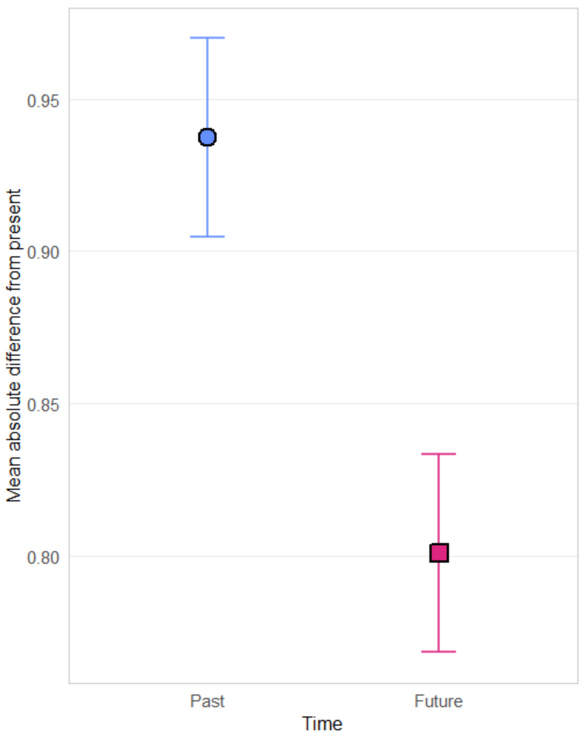
E1 Results (Domain Specific Questions)
Main Effect of Temporal Direction
F(1, 1061) = 78.80, p < 0.0001
Positive EHI effect

Slide 8
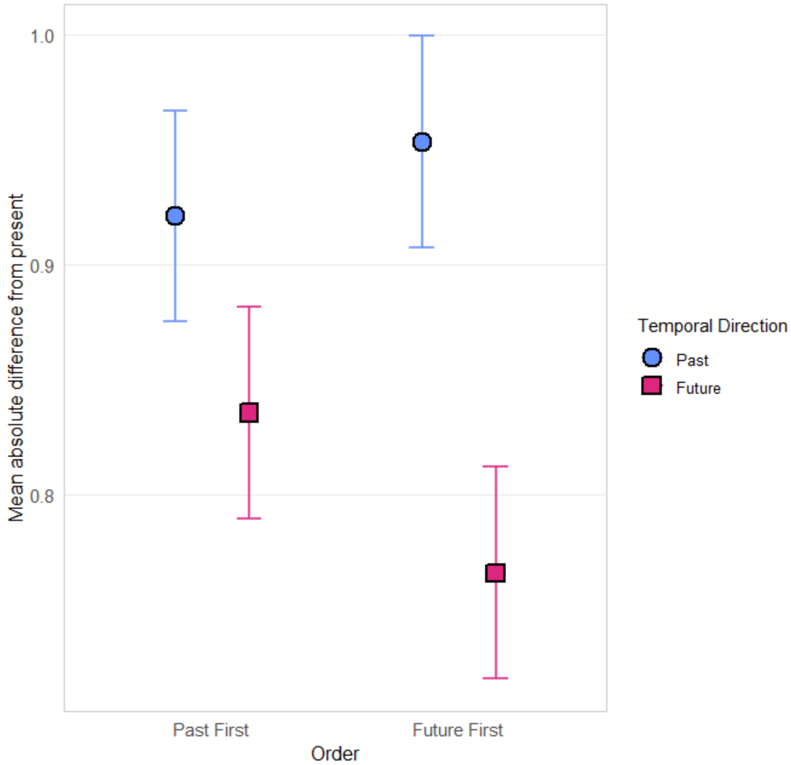
E1 Results (Domain Specific): Temporal Display Order by Temporal Direction
Notes:
Both contrasts significant
TEMPORAL_DO = 01PAST:
contrast estimate SE df t.ratio p.value
Past - Future 0.0856 0.0217 1061 3.952 0.0001
TEMPORAL_DO = 02FUT:
contrast estimate SE df t.ratio p.value
Past - Future 0.1876 0.0219 1061 8.583 <.0001

Slide 9
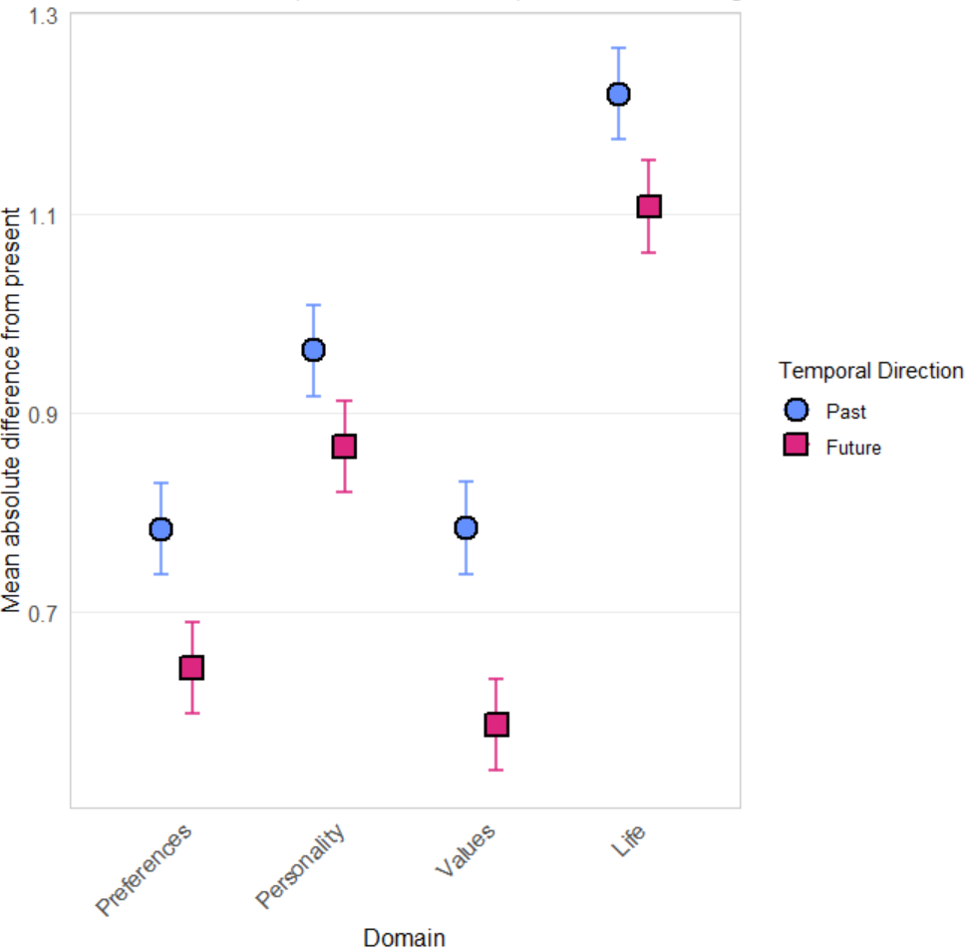
E1 Results (Domain Specific): Domain by Temporal Direction
Notes:
All contrasts are significant
DOMAIN = Preferences:
contrast estimate SE df t.ratio p.value
Past - Future 0.13902794 0.02525902 3935.86 5.504 <.0001
DOMAIN = Personality:
contrast estimate SE df t.ratio p.value
Past - Future 0.09663259 0.02525902 3935.86 3.826 0.0001
DOMAIN = Values: contrast estimate SE df t.ratio p.value
Past - Future 0.19752790 0.02525902 3935.86 7.820 <.0001
DOMAIN = Life:
contrast estimate SE df t.ratio p.value
Past - Future 0.11322255 0.02525902 3935.86 4.482 <.0001

Slide 10
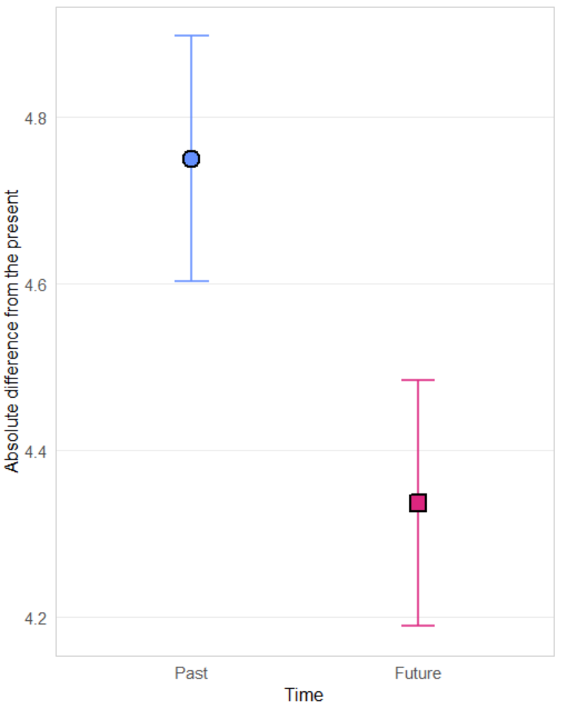
E1 Results (Domain General Question)
Main effect of temporal direction
F(1, 1061) = 67.47, p < 0.0001
Overall positive EHI effect
No significant interaction effects with temporal direction

Slide 11
E1 correlations
 | AOT | CRT (correct response) | CRT (intuitive response)
domain-specific mean | -0.012 | -0.051 | 0.035
domain-general mean | -0.25*** | -0.078* | 0.027
*p < 0.05
***p < 0.001
Notes:
Domain-specific mean correlation is not significant, but when broken down into past vs future domain means, there are significant correlations
Var 1 var 2 s. rho p
NFut_mean_total CRT_correct -0.08264 0.007025
NFut_mean_total AOT_total -0.0721 0.018723
NFut_mean_total CRT_int 0.062094 0.042964
Domain-general mean correlations broken down by past/future, show that both time frames correlate significantly w/ AOT and CRT(correct)
Var 1 var 2 s. rho p
DGEN_fut_mean AOT_total -0.29597 < 0.0001
DGEN_fut_mean CRT_correct -0.10997 0.000328
DGEN_past_mean AOT_total -0.22578 9.41E-14
DGEN_past_mean CRT_correct -0.06023 0.049629

Slide 12
Experiment 2: Methods Modifications
N = 489
Added within-subjects variable (interval): present, past 5 years, past 10 years, future 5 years, future 10 years
  For both domain specific and domain general questions
  Removed “life satisfaction” domain for brevity
Added between-subjects variable: interval display order (in the past or future time frame, was 5 years in the past/future or 10 years in the past/future displayed first?)

Slide 13
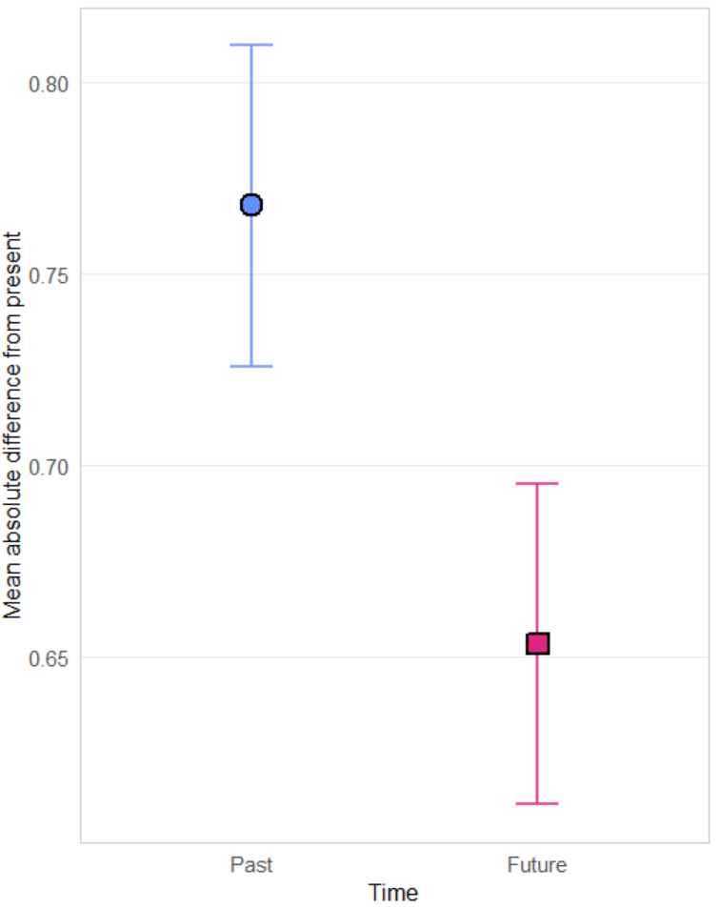
E2: Results (Domain Specific)
Main effect of temporal direction
F(1, 486) = 40.323, p < 0.0001
Positive EHI effect

Slide 14
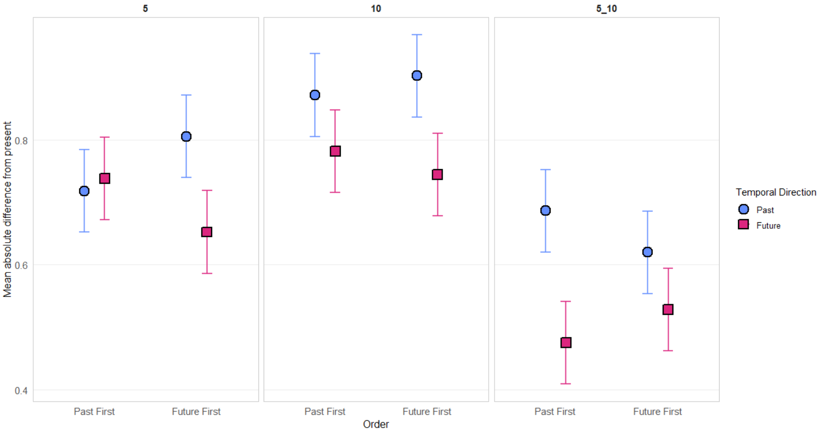
Exp2 (Domain Specific Questions): Temporal Display Order x Temporal Direction x Interval
Notes:
Most contrasts are significant (only the first isn’t – the rest are bolded):
INTERVAL = 5, TEMPORAL_DO = 01PAST:
contrast estimate SE df t.ratio p.value
Past - Future -0.0199 0.0318 1023 -0.628 0.5301
INTERVAL = 10, TEMPORAL_DO = 01PAST:
contrast estimate SE df t.ratio p.value
Past - Future 0.0901 0.0318 1023 2.838 0.0046
INTERVAL = 5_10, TEMPORAL_DO = 01PAST:
contrast estimate SE df t.ratio p.value
Past - Future 0.2113 0.0318 1023 6.652 <.0001
INTERVAL = 5, TEMPORAL_DO = 02FUT:
contrast estimate SE df t.ratio p.value
Past - Future 0.1536 0.0318 1023 4.829 <.0001
INTERVAL = 10, TEMPORAL_DO = 02FUT:
contrast estimate SE df t.ratio p.value
Past - Future 0.1587 0.0318 1023 4.991 <.0001
INTERVAL = 5_10, TEMPORAL_DO = 02FUT:
contrast estimate SE df t.ratio p.value
Past - Future 0.0916 0.0318 1023 2.880 0.0041

Slide 15
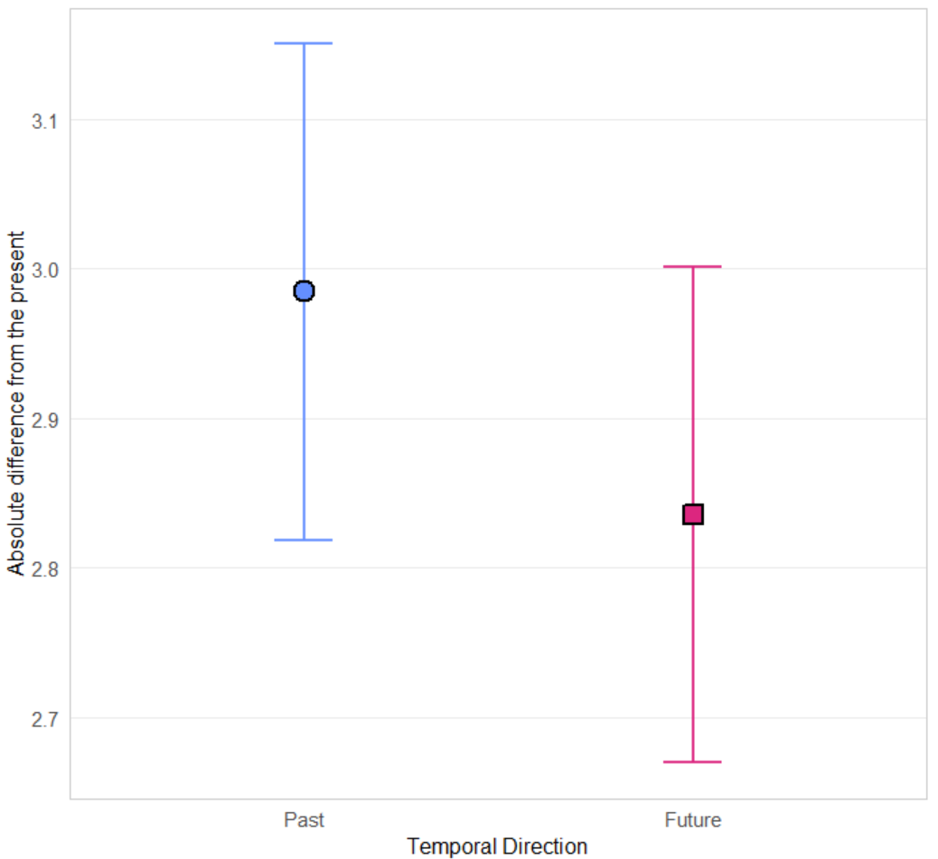
E2: Results (Domain General)
Main effect of temporal direction
F(1, 486) = 7.959, p = 0.00498
Positive EHI effect

Slide 16
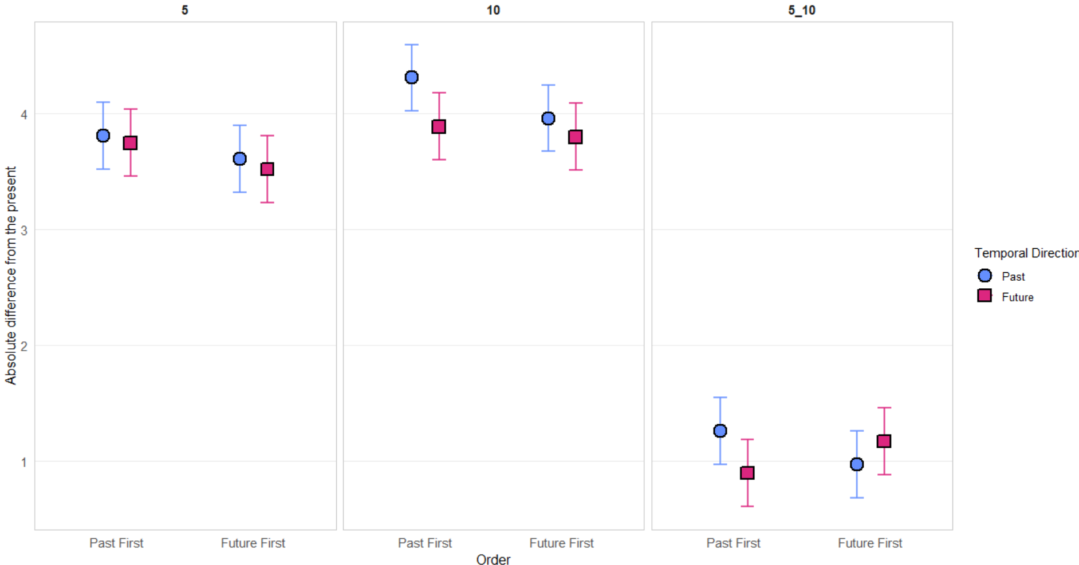
Exp2 (Domain General Questions): Temporal Display Order x Temporal Direction x Interval
Notes:
Significant contrasts:
temporal_DO = 01PAST, INTERVAL = 10:
contrast estimate SE df t.ratio p.value
Past - Future 0.4221 0.0999 1191 4.224 <.0001
temporal_DO = 01PAST, INTERVAL = 5_10:
contrast estimate SE df t.ratio p.value
Past - Future 0.3616 0.0999 1191 3.618 0.0003
temporal_DO = 02FUT, INTERVAL = 5_10:
contrast estimate SE df t.ratio p.value
Past - Future -0.2016 0.1000 1191 -2.014 0.0442

Slide 17
Conclusions
Positive EHI effect across both experiments, replicating results of Quoidbach et al. (2013)
EHI is stable across domains, strongest across preferences and values.
EHI is stable across temporal display order.
  For domain-specific questions, there is a larger effect between past-future when the future time frame is displayed first
Results of experiment 2 provide show higher perceived changes in both past and future directions in the first 5-year interval from the present, as compared to the 5-10 time interval, indicating there is a front-loading effect to EHI.

