Slide 1
PLACE L2 HERE (DG LEVEL)
Individual differences in the end-of-history-illusion and the effect of time horizon
Irina Levit
Inderpreet Gill
David Mandel

Slide 2
Introduction
EHI = tendency to underestimate the amount of future change, relative to past change, over the same time period

Slide 3
Experiment 1: methods
N = 1063
Between-subjects: temporal display order (“past first” vs. “future first”)
Within-subjects:
  Present, past, future domain specific questions (preferences, personality, values, life)
  Past and future domain general questions
Counterbalanced variables: task display order, item display order (domain general vs domain specific questions), domain display order (4 groups alternating which domain is shown first: preferences, personality, values, life)
Notes:
Present always first. Past first and future first toggled between participants, and refer to the time frame that is displayed after present time frame.

Slide 4
Exp1: Methods Cont’d
Domain specific questions: wording amended to reflect time frame of interest
For example, preferences (items: read, watch tv, nap, listen to music, travel):
  Present: For the following statements, tell us about the likes and dislikes that you currently have.
    I like to read.
  Past: For the following statements, tell us about the likes and dislikes that you had 10 years ago.
    10 years ago, I liked to read.
  Future: For the following statements, tell us about the likes and dislikes that you expect to have 10 years from now.
    10 years from now, I will like to read.
Domain general questions (past & future):
How similar or different are your current likes and dislikes compared to what they were 10 years ago?
How similar or different are your current likes and dislikes compared to what you expect them to be 10 years from now?
Notes:
The display order of domain specific and domain general questions was counterbalanced so that ~50% answered domain specific questions first, and then domain general questions, and half in the reverse order.

Slide 5
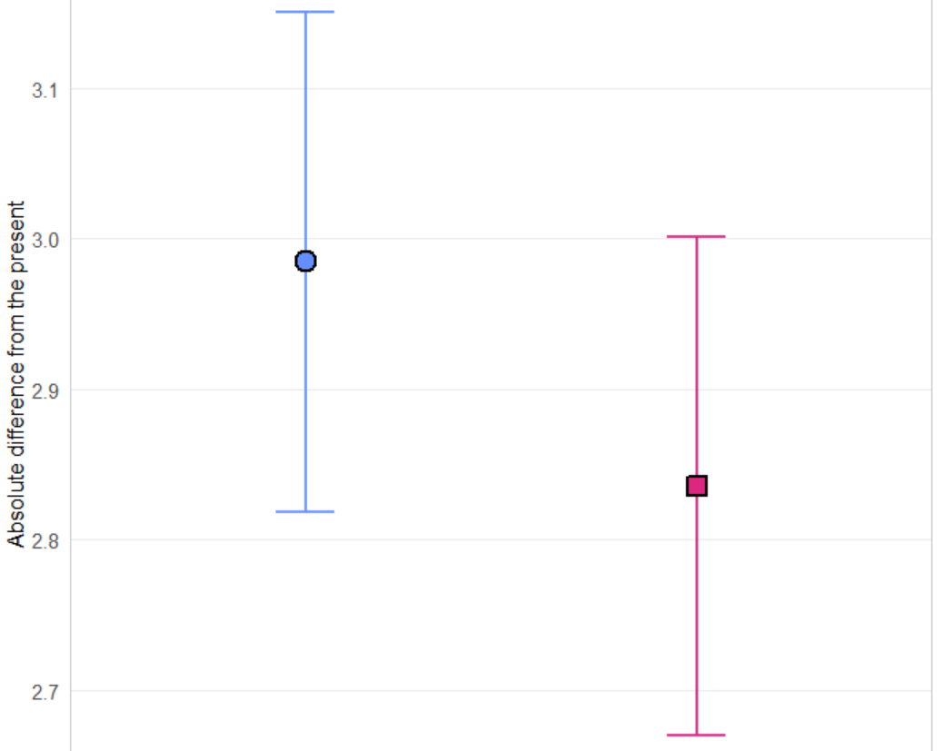
E1 Results (Domain Specific Questions)
Main Effect of Temporal Direction
F(1, 1061) = 78.80, p < 0.0001
Positive EHI effect
Notes:
Main Effect of time

Slide 6
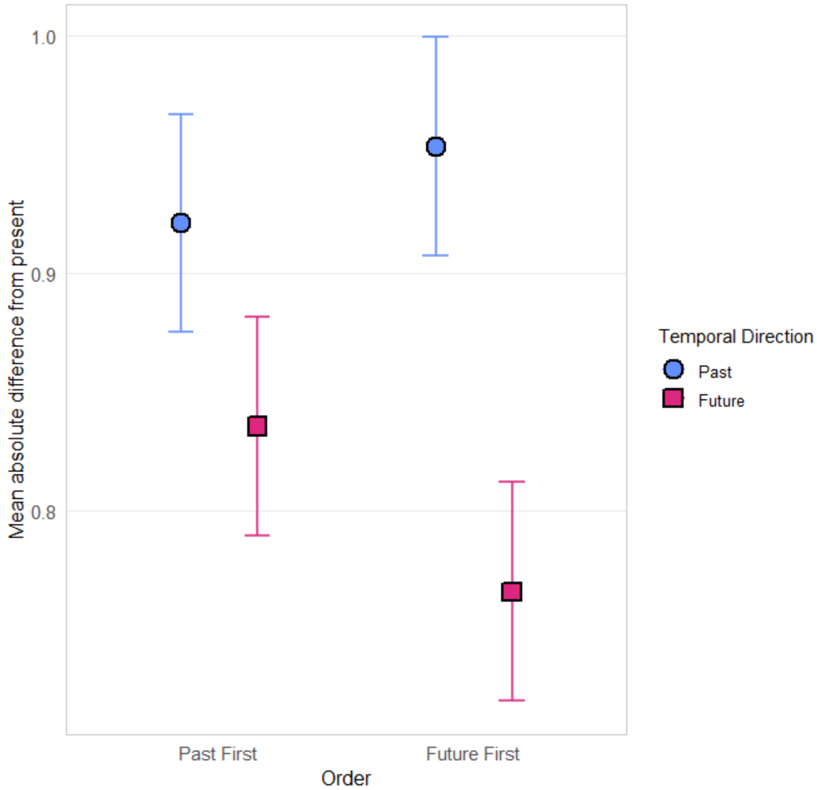
E1 Results (Domain Specific): Temporal Display Order by Temporal Direction

Slide 7
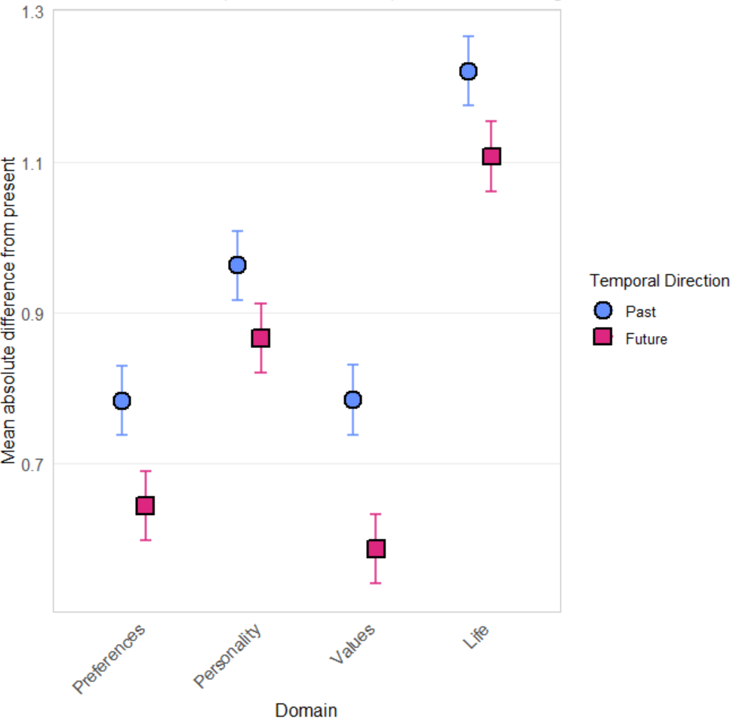
E1 Results (Domain Specific): Domain by Temporal Direction

Slide 8
E1 Results (Domain General Question)
Main effect of temporal direction
F(1, 1061) = 67.47, p < 0.0001
Overall positive EHI; t(1061) = 8.21, p < 0.0001
No significant interaction effects with temporal direction

Slide 9
Experiment 2: Methods Modifications
N = 490
Added within-subjects variable (interval): present, past 5 years, past 10 years, future 5 years, future 10 years
  For both domain specific and domain general questions
Added between-subjects variable: interval display order (in the past or future time frame, was 5 years in the past/future or 10 years in the past/future displayed first?)
Main effects of temporal direction:
  Overall positive EHI: F(1, 486) = 40.32, p < 0.0001

Slide 10
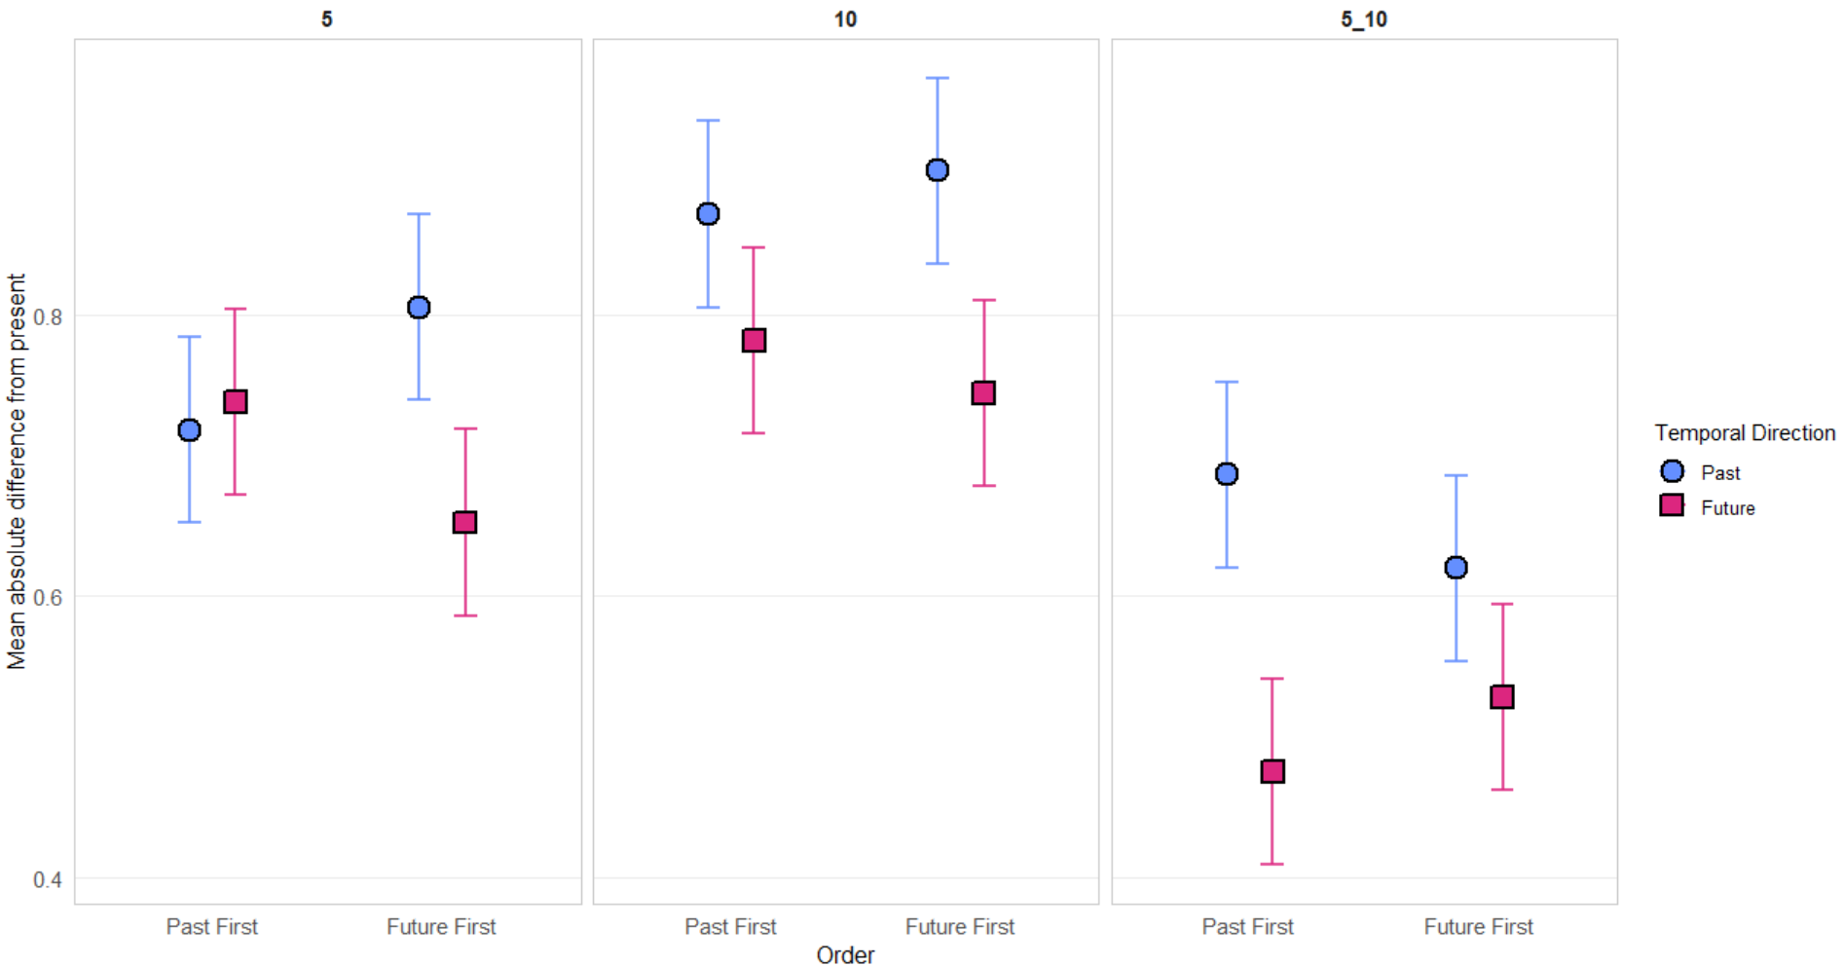
Exp2 (Domain Specific Questions): Temporal Display Order x Temporal Direction x Interval

Slide 11
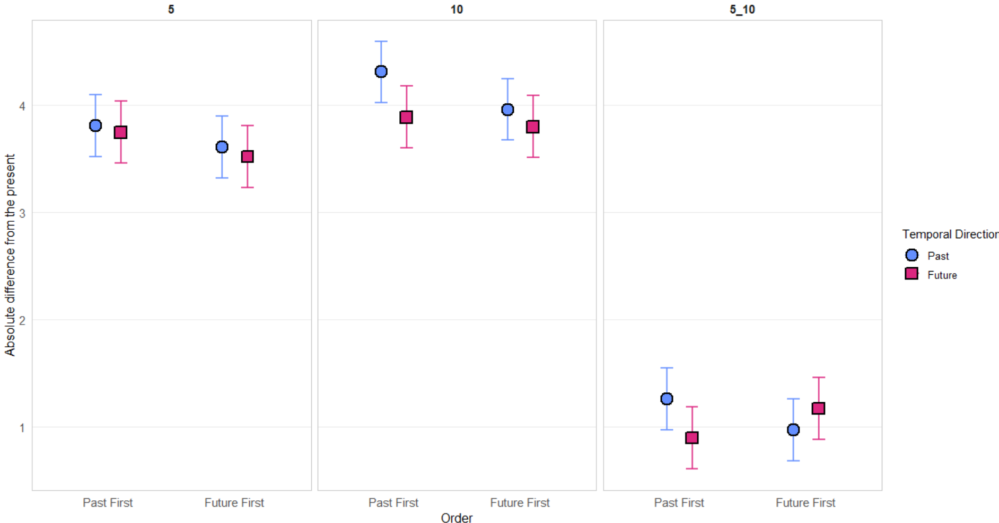
Exp2 (Domain General Questions): Temporal Display Order x Temporal Direction x Interval

Slide 12
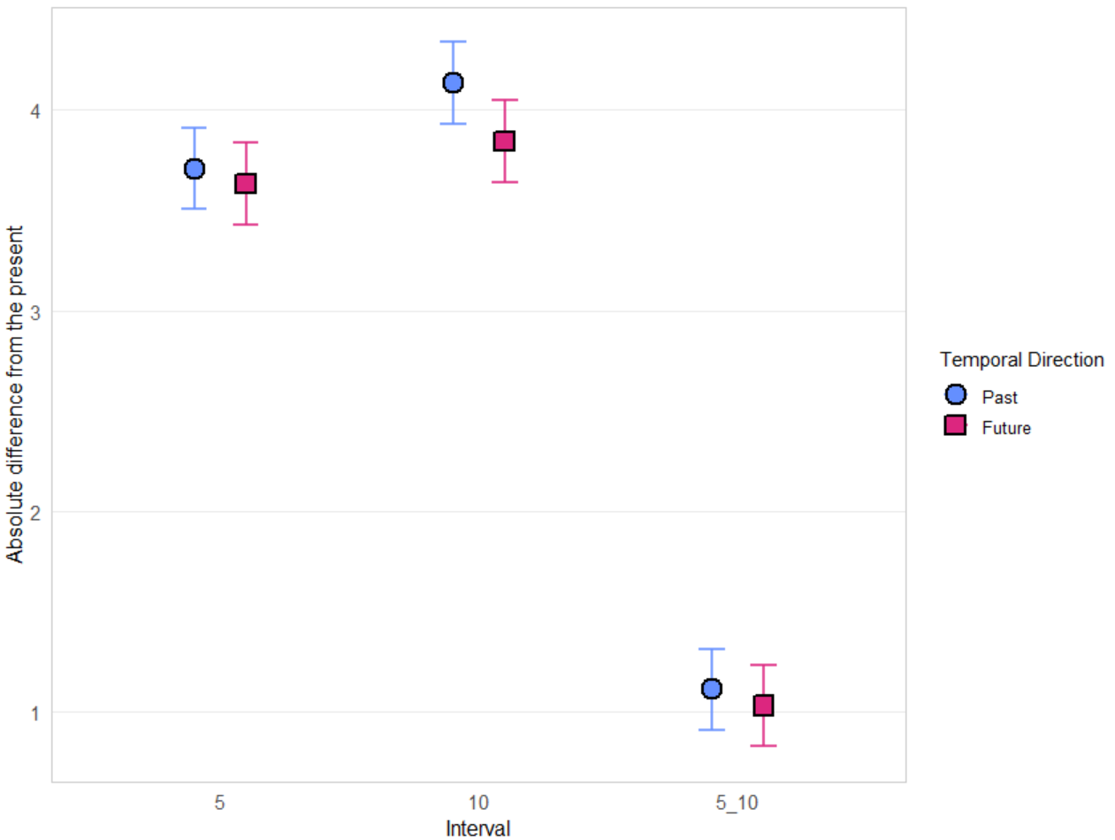
E2 (domain general): interval x temporal direction

Slide 13
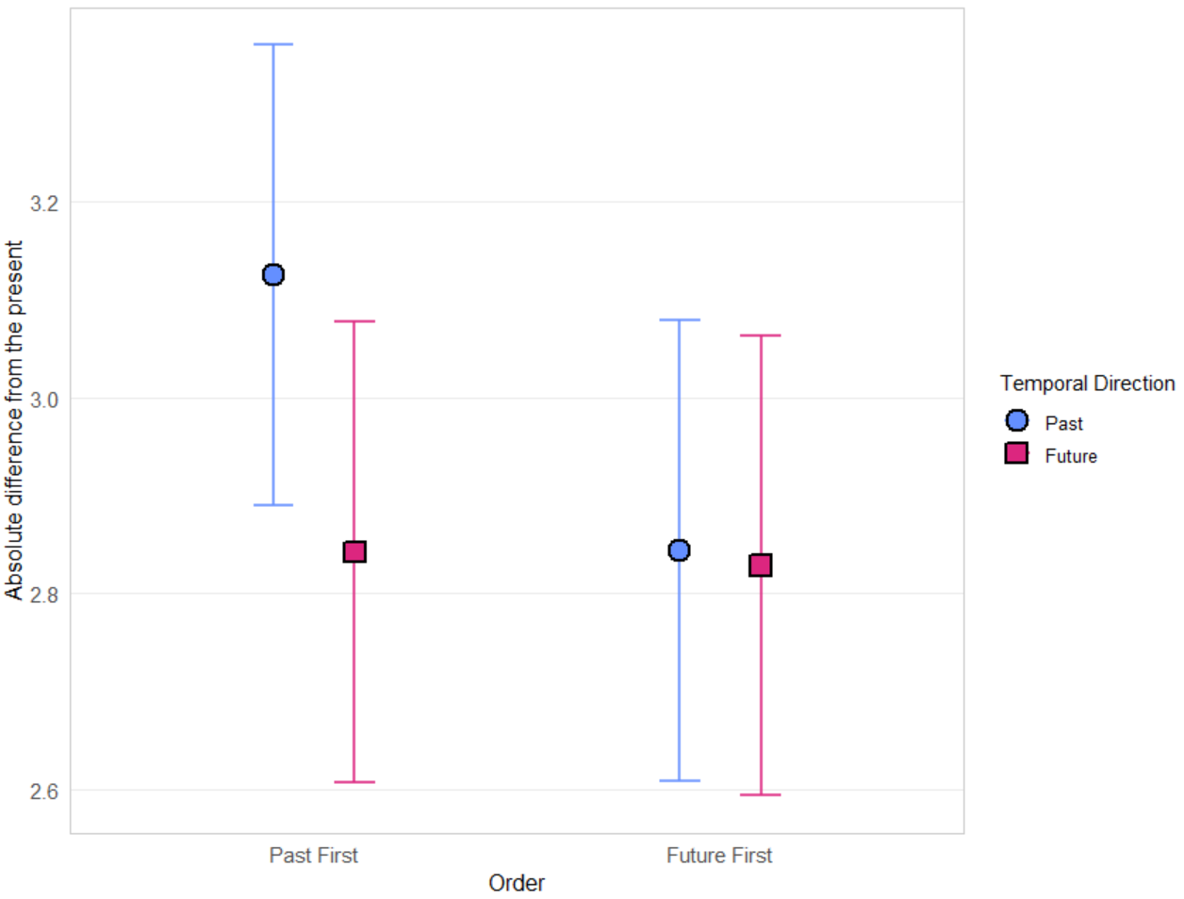
E2 (DGEN): temporal_DO x temporal direction

