Slide 1
DGRDSE
The end-of-history-illusion: variations across domains, timeframes and individuals
Irina Levit, Inderpreet Gill, & David Mandel

Slide 2
Introduction
EHI = tendency to underestimate the amount of future change, relative to past change, over the same time period.
Based on the work of Quoidbach, J., Gilbert, D. T., & Wilson, T. D. (2013). The end of history illusion. Science, 339(6115), 96–98. https://doi.org/10.1126/science.1229294
  >19,000 participants across 6 studies, divided into reporters vs predictors.
  Results:
    EHI effects across multiple domains: preferences, personality, values.
    EHI effects occur across age, although magnitude reduces in older age.
    Participants overpaid for future experiences, underestimating how much their preferences may change in the future.

Slide 3
Introduction to Experiment 1
Aim: replicate EHI findings of Quoidbach et al. while incorporating methodological improvements and a general knowledge calibration task.
Task 1: EHI effect
Task 2: Calibration and accuracy of probabilistic judgements (Brier score)
RQ1: How do domain-specific items (items within domains of preferences, personality, life satisfaction, and values), temporal direction (past vs future), and temporal display order affect EHI?
RQ2: How do domain-general items (perception of overall domain change), temporal direction, and temporal display order affect EHI?
RQ3: What is the relationship between EHI effect and calibration?
RQ4: What is the relationship between EHI effect and individual difference measures?

Slide 4
E1 Methods: Task 1 (EHI)
N = 1063 recruited online via Qualtrics Panels
Between-subjects: temporal display order (“past first” vs. “future first”)
Within-subjects:
  Present, past, future domain specific questions (preferences, personality, values, life)
  Past and future domain general questions
Counterbalanced variables: task display order, item display order (domain general vs domain specific questions), domain display order (4 groups alternating which domain is shown first: preferences, personality, values, life)
Notes:
Present always first. Past first and future first toggled between participants, and refer to the time frame that is displayed after present time frame.

Slide 5
E1 Methods: EHI cont’d
Domain specific questions: wording amended to reflect time frame of interest
For example, preferences (items: read, watch tv, nap, listen to music, travel):
  Present: For the following statements, tell us about the likes and dislikes that you currently have.
    I like to read.
  Past: For the following statements, tell us about the likes and dislikes that you had 10 years ago.
    10 years ago, I liked to read.
  Future: For the following statements, tell us about the likes and dislikes that you expect to have 10 years from now.
    10 years from now, I will like to read.
  Statements were responded to on a likert scale (where -3 = strongly disagree, and 3 = strongly agree)
Domain general questions (past & future):
How similar or different are your current likes and dislikes compared to what they were 10 years ago?
How similar or different are your current likes and dislikes compared to what you expect them to be 10 years from now?
These questions were answered on a slider scale, where 0 = completely similar and 10 = completely different
Notes:
The display order of domain specific and domain general questions was counterbalanced so that ~50% answered domain specific questions first, and then domain general questions, and half in the reverse order. The display order for statements of each domain were randomized.
Our methods have a methodological improvement in including both perceived past and perceived future change in all participants, as opposed to dividing participants into those who report on past change and those who predict future change.
We also included counterbalancing for display order of which time frame was displayed (past vs future).

Slide 6
Exp1 Domain-Specific Items
Preferences
Personality
I like to read.
I like to watch TV.
I like to nap.
I like to listen to music.
I like to travel.
I am extraverted and enthusiastic.
I am critical and quarrelsome.
I am dependable and self-disciplined.
I am anxious and easily upset.
I am complex and open to new experiences.
Values
Life Satisfaction
It is important to me to obey all laws.
It is important to me to maintain traditional values and ways of thinking.
It is important to me to develop my own opinions.
It is important to me to show that my performance is better compared to the performance of other people.
It is important to me that everyone be treated justly, even people that I don’t know.
In most ways my life is close to my ideal.
The conditions of my life are excellent.
I am satisfied with my life.
So far I have gotten the important things I want in life.
If I could live my life over, I would change almost nothing.
Notes:
For each participant, the display order of the items within each domain was randomized.

Slide 7
Scale/Inventory Sources
Preferences (amended items that appear in these references)
Jopp, D., & Hertzog, C. (2010). Assessing adult leisure activities: An extension of a self-report activity questionnaire. Psychological Assessment, 22(1), 108–120. https://doi.org/10.1037/a0017662
Rommerskirch-Manietta, M., Bergmann, J. M., Manietta, C., Purwins, D., Van Haitsma, K., Abbott, K. M., & Roes, M. (2024). Exploration of the content and structure of preferences for leisure activities of people receiving adult day services using concept mapping. The Gerontologist, 64(5), gnad142. https://doi.org/10.1093/geront/gnad142
Personality
Gosling, S. D., Rentfrow, P. J., & Swann Jr, W. B. (2003). A very brief measure of the Big-Five personality domains. Journal of Research in personality, 37(6), 504-528.
Values
Lechner, C. M., Beierlein, C., Davidov, E., & Schwartz, S. H. (2024). Measuring the Four Higher-Order Values in Schwartz’s Theory: Validation of a 17-Item Inventory. Journal of Personality assessment, 106(5), 651-664.
Life Satisfaction
Diener, E. D., Emmons, R. A., Larsen, R. J., & Griffin, S. (1985). The satisfaction with life scale. Journal of personality assessment, 49(1), 71-75.
Notes:
For Preferences, some of the items that appear in sources were collapsed to form the items present here. For example, relaxing and resting were collapsed into the item “nap” (per inderpreet’s email).
For values, the items are from Schwartz’s 17 item inventory. There are 4 listed higher order values. Per Inderpreet, 2 items from taken from “Conservation”, and 1 item each was taken from “openness to Change”, “self-enhancement”, and “self-transcendence”

Slide 8
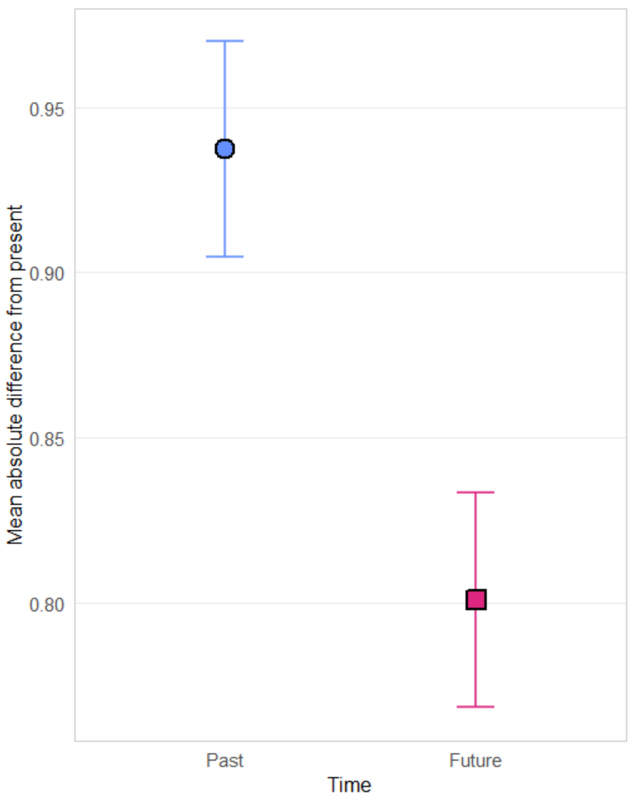
E1 (EHI task) Results: Domain Specific Questions
Main Effect of Temporal Direction
F(1, 1061) = 78.80, p < 0.0001
Demonstrates EHI in first within-subjects design.

Slide 9
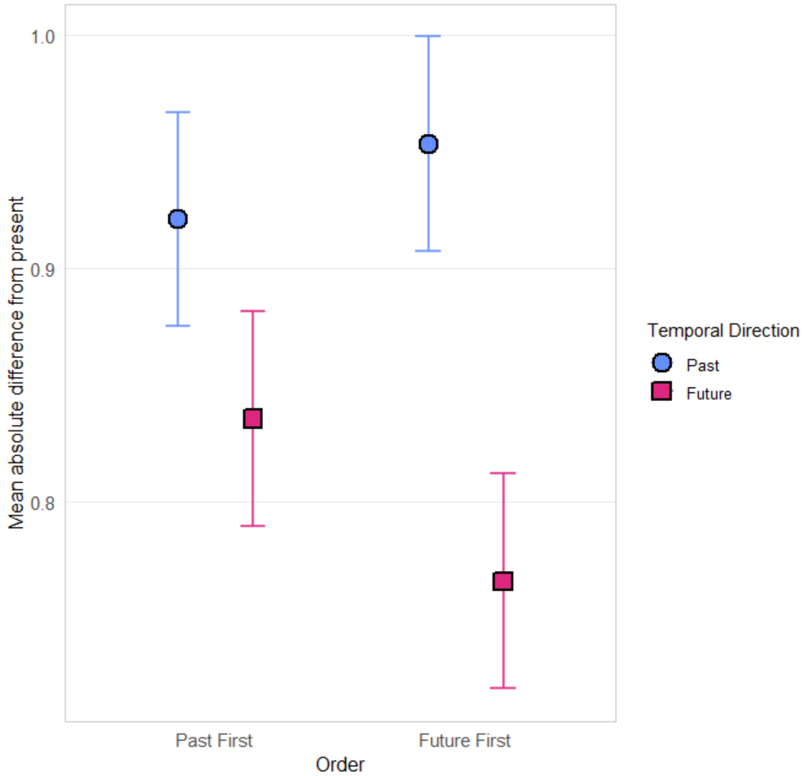
E1 (EHI task) Results (Domain Specific): Temporal Display Order by Temporal Direction
Notes:
Both contrasts significant
TEMPORAL_DO = 01PAST:
contrast estimate SE df t.ratio p.value
Past - Future 0.0856 0.0217 1061 3.952 0.0001
TEMPORAL_DO = 02FUT:
contrast estimate SE df t.ratio p.value
Past - Future 0.1876 0.0219 1061 8.583 <.0001

Slide 10
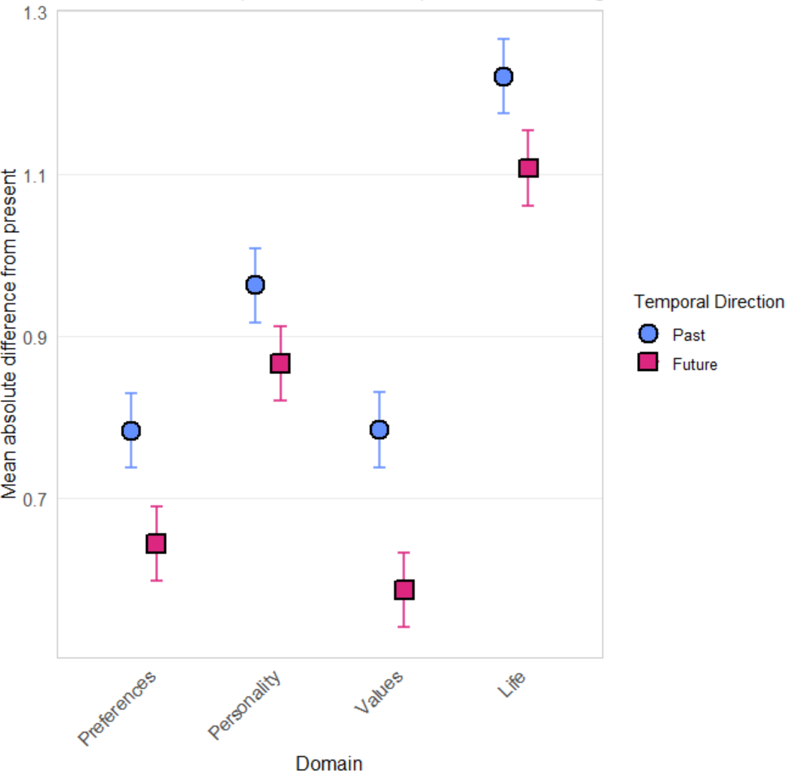
E1 (EHI task) Results (Domain Specific): Domain by Temporal Direction
Notes:
All contrasts are significant
DOMAIN = Preferences:
contrast estimate SE df t.ratio p.value
Past - Future 0.13902794 0.02525902 3935.86 5.504 <.0001
DOMAIN = Personality:
contrast estimate SE df t.ratio p.value
Past - Future 0.09663259 0.02525902 3935.86 3.826 0.0001
DOMAIN = Values: contrast estimate SE df t.ratio p.value
Past - Future 0.19752790 0.02525902 3935.86 7.820 <.0001
DOMAIN = Life:
contrast estimate SE df t.ratio p.value
Past - Future 0.11322255 0.02525902 3935.86 4.482 <.0001

Slide 11
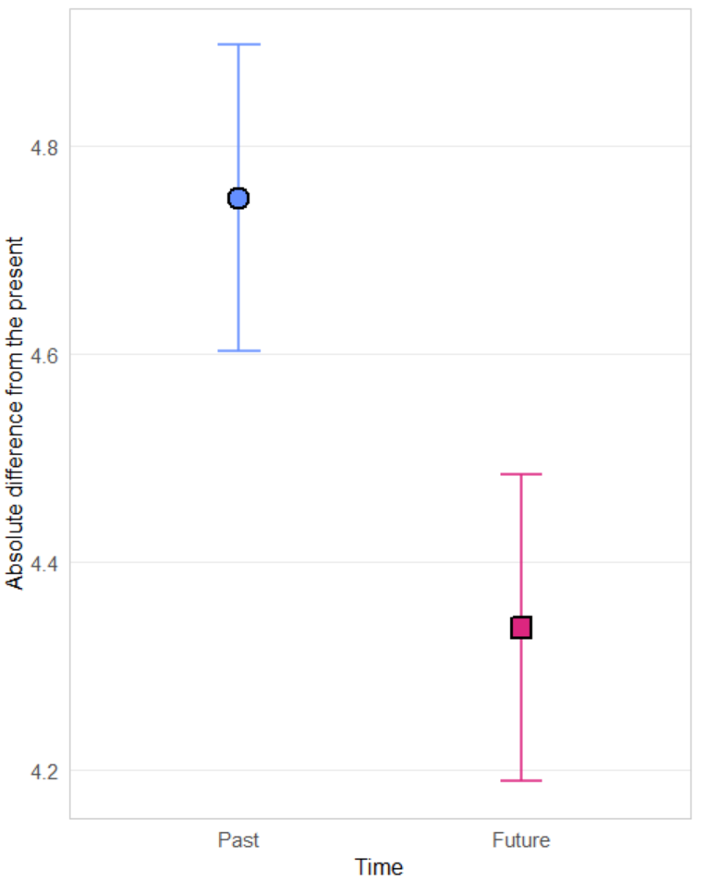
E1 (EHI task) Results: Domain General Question
Main effect of temporal direction
F(1, 1061) = 67.47, p < 0.0001
Again demonstrating EHI
No significant interaction with temporal direction

Slide 12
E1 correlations: EHI effect with individual difference measures
 | AOT | CRT (correct response) | CRT (intuitive response)
domain-specific EHI | 0.085** | 0.051 | -0.057
domain-general EHI | 0.11*** | 0.067* | -0.057
Note: Correlations are computed using Spearman’s rho.
*p < 0.05
**p < 0.01
***p < 0.001
Notes:
Significant domain-specific correlations broken down by domain
Var 1 var 2 s. rho p
ehi_life_mean AOT_total 0.072949943 0.017369
ehi_pref_mean CRT_correct 0.068917794 0.02464
ehi_pref_mean CRT_int -0.064728497 0.034848
Significant domain-general correlations broken down by domain
Var 1 var 2 s. rho p
eohiDGEN_life AOT_total 0.117946108 0.000116
eohiDGEN_pers AOT_total 0.091596281 0.002798
eohiDGEN_pref AOT_total 0.068355715 0.025838
eohiDGEN_val AOT_total 0.103955004 0.000687
eohiDGEN_val CRT_correct 0.074789341 0.01473
eohiDGEN_val CRT_int -0.06044435 0.048816
In case anyone asks, these are the CRT questions:
A bat and a ball cost $1.10 in total. The bat costs $1.00 more than the ball. How much does the ball cost?
Correct response: 5 cents
Intuitive response: 10 cents
If it takes 5 machines 5 minutes to make 5 widgets, how long would it take 100 machines to make 100 widgets?
Correct response: 5 minutes
Intuitive response: 100 minutes
In a lake, there is a patch of lily pads. Every day, the patch doubles in size. If it takes 48 days for the patch to cover the entire lake, how long would it take for the patch to cover half of the lake?
Correct response: 47 days
Intuitive response: 24 days

Slide 13
E1 Methods: Task 2
32 general knowledge questions chosen from 4 accuracy range
Coane, J. H., &; Umanath, S. (2021). A database of general knowledge question performance in older adults. Behavior Research Methods, 53(1), 415-429.
Questions adapted to a “True”/”False” format; for each question:
  Participants chose whether the statement was “True” or “False”
  Participants rated their confidence with their chosen answer, on a scale of 50 (“not at all confident, essentially a coin toss”) to 100 (“absolutely confident, no chance of being wrong”)
2 Measures:
Brier score (see next slide)
Calibration = [the number of questions that the participant thinks they answered correctly] – [the number of questions that the participant actually answered correctly]

Slide 14

E1 Methods: Task 2 (Brier Score)
N = # of total forecasts (34,016 for E1)
t = individual forecast
f_{t} = predicted probability of individual forecast (0-1)
o_{t} = outcome of the event (0, 1)
  For questions where correct answer is True:
    f_{t} is calculated as (C – 1)² when participant chooses “True”
    f_{t} is calculated as [(1 – C) – 1]² when participant chooses “False”
  For questions where correct answer is False:
    f_{t} is calculated as (C – 0)² when participant chooses “True”
    f_{t} is calculated as [(1 – C) – 0]² when participant chooses “False”
  C = participant’s stated confidence for the individual forecast, expressed as a proportion
Lower brier scores correspond to better forecasting accuracy (0 = perfect forecasting accuracy)
Notes:
34,016 = # of participants x # of individual predictions = 1063 x 32
Brier score was amended when participants chose answer “False” so that all scores are expressed in a consistent frame (“True”).

Slide 15
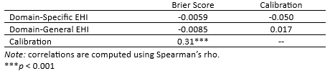
E1 correlations: EHI effect with Brier score
Notes:
var_x var_y spearman r p
bs_hard cal | _selfActual 0.351630149 2.70487E-32
cal_selfActual | ehi_val_mean -0.099629152 0.001143742
bs_easy | eohiDGEN_life -0.087676604 0.004226705
cal_selfActual | ehi_pers_mean -0.082807345 0.006907147

Slide 16
Introduction to Experiment 2
Aim: expand on the EHI findings from Experiment 1 and Quoidbach et al., and incorporating time intervals to assess
RQ1: How do domain-specific items (items within domains of preferences, personality, life satisfaction, and values), temporal direction (past vs future), interval, interval display order, and temporal display order affect EHI?
RQ2: How do domain-general items (perception of overall domain change), temporal direction, interval, interval display order, and temporal display order affect EHI?
RQ3: What is the relationship between EHI effect and individual difference measures?

Slide 17
Experiment 2: Methods Modifications
N = 489 recruited online via Qualtrics Panels
Added within-subjects variable (interval): present, past 5 years, past 10 years, future 5 years, future 10 years
  For both domain-specific and domain-general questions
  Removed “life satisfaction” domain for brevity
Added between-subjects variable: interval display order (in the past or future time frame, was 5 years in the past/future or 10 years in the past/future displayed first?)
Notes:
Domain general question was still asked on a slider scale but 0 read “exactly the same” (versus “completely similar” in E1)

Slide 18
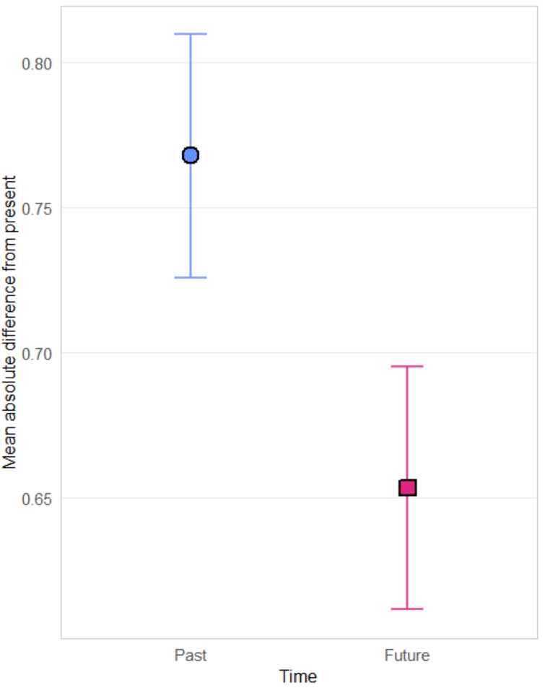
E2: Results (Domain Specific)
Main effect of temporal direction
F(1, 486) = 40.323, p < 0.0001
Demonstrates EHI effect

Slide 19
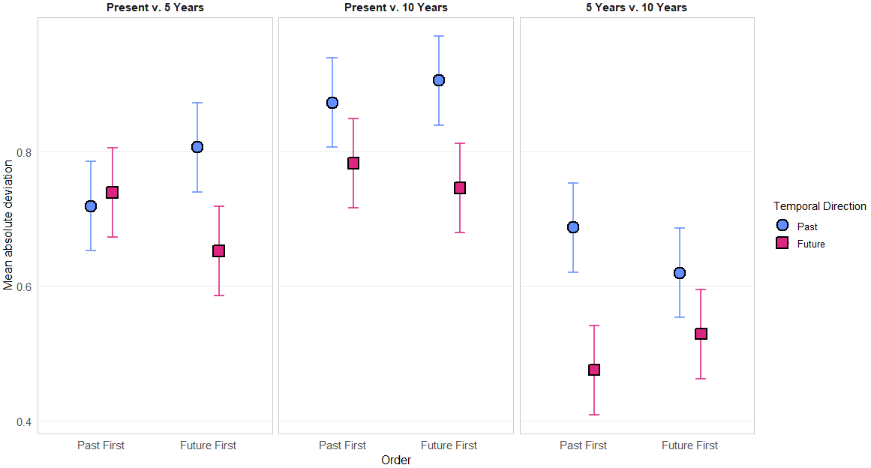
Exp2 (Domain Specific Questions): Temporal Display Order x Temporal Direction x Interval
Notes:
Most contrasts are significant (only the first isn’t – the rest are bolded):
INTERVAL = 5, TEMPORAL_DO = 01PAST:
contrast estimate SE df t.ratio p.value
Past - Future -0.0199 0.0318 1023 -0.628 0.5301
INTERVAL = 10, TEMPORAL_DO = 01PAST:
contrast estimate SE df t.ratio p.value
Past - Future 0.0901 0.0318 1023 2.838 0.0046
INTERVAL = 5_10, TEMPORAL_DO = 01PAST:
contrast estimate SE df t.ratio p.value
Past - Future 0.2113 0.0318 1023 6.652 <.0001
INTERVAL = 5, TEMPORAL_DO = 02FUT:
contrast estimate SE df t.ratio p.value
Past - Future 0.1536 0.0318 1023 4.829 <.0001
INTERVAL = 10, TEMPORAL_DO = 02FUT:
contrast estimate SE df t.ratio p.value
Past - Future 0.1587 0.0318 1023 4.991 <.0001
INTERVAL = 5_10, TEMPORAL_DO = 02FUT:
contrast estimate SE df t.ratio p.value
Past - Future 0.0916 0.0318 1023 2.880 0.0041

Slide 20
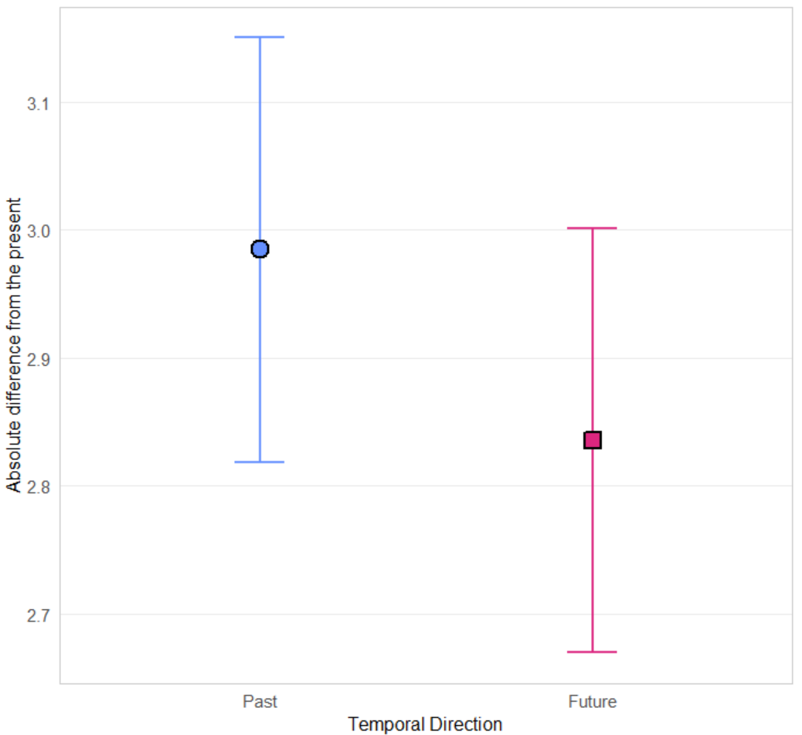
E2: Results (Domain General)
Main effect of temporal direction
F(1, 486) = 7.959, p = 0.00498
Positive EHI effect

Slide 21
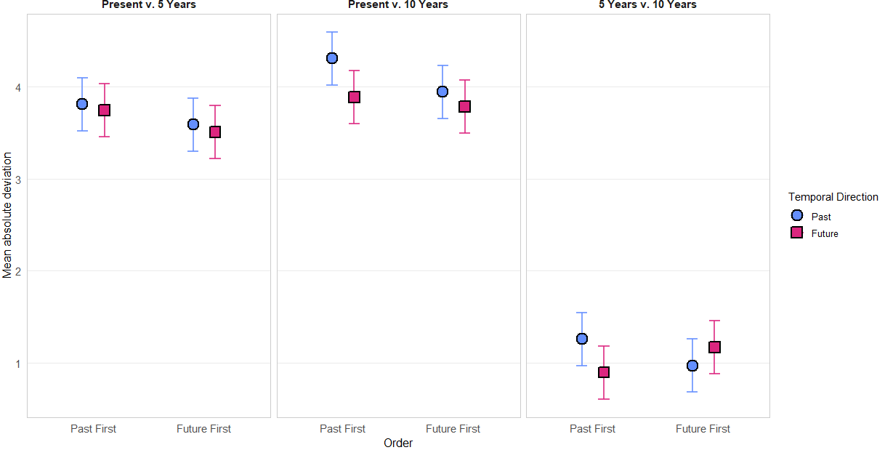
Exp2 (Domain General Questions): Temporal Display Order x Temporal Direction x Interval
Notes:
Significant contrasts:
temporal_DO = 01PAST, INTERVAL = 10:
contrast estimate SE df t.ratio p.value
Past - Future 0.4221 0.0999 1191 4.224 <.0001
temporal_DO = 01PAST, INTERVAL = 5_10:
contrast estimate SE df t.ratio p.value
Past - Future 0.3616 0.0999 1191 3.618 0.0003
temporal_DO = 02FUT, INTERVAL = 5_10:
contrast estimate SE df t.ratio p.value
Past - Future -0.2016 0.1000 1191 -2.014 0.0442

Slide 22
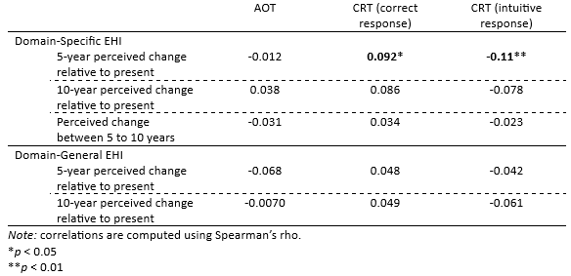
E2: correlations
Notes:
Variable1 Variable2 Spearman_r P_value
ehiDGEN_5_Pers aot_total -0.136252077 0.002533
(ehiDGEN_5_Pers is the ehi effect for DGEN past 5 year – future 5 year in the personality domain)
ehi5_pref_MEAN crt_int -0.111269786 0.01382
ehi5_pref_MEAN crt_correct 0.092043471 0.041901
(ehi5_pref_MEAN is the mean of the ehi effects for each of the 5 items in preferences)

Slide 23
Conclusions
Positive EHI effect across both experiments, generalizing results of Quoidbach et al. (2013) to a within-subject design permitting individual difference measures of EHI
EHI is stable across domains, strongest across preferences and values.
EHI is stable across temporal display order, but for domain-specific questions, EHI is larger when future judgments are elicited first.
Experiment 2 reveals that the past/future contribution to EHI is small relative to the “now” vs. “Not now” effect. In other words, perceived change rapidly decelerates in both directions relative to “now.”

