Slide 1
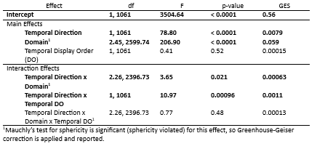
E1 Results: Mixed Analysis of Variance (ANOVA) for Domain Specific Questions

Slide 2
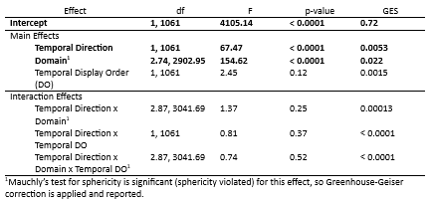
E1 Results: Mixed ANOVA for Domain General Questions
Notes:
Domain x temporal display order also significant
F(2.74, 2902.95) = 3.38, p < 0.0001, ges = 0.00048

Slide 3
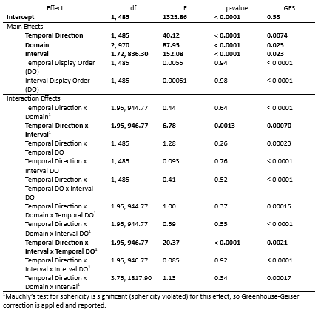
E2 Results: Mixed ANOVA for Domain Specific Questions
Notes:
Domain x interval is also significant
F (3.55, 1721.4) = 10.60, p < 0.0001, ges = 0.0018

Slide 4
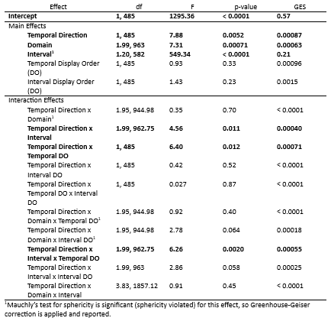
E2 Results: Mixed ANOVA for Domain General Questions

